Slide 1
Chapter 1 – Architectural Design
Software Architecture and Design
Mutah University
Faculty of IT
Department of Software Engineering
Dr. Ra’Fat A. AL-Msie’Deen
rafatalmsiedeen@mutah.edu.jo
https://rafat66.github.io/Al-Msie-Deen/

Slide 2
Review

Slide 3
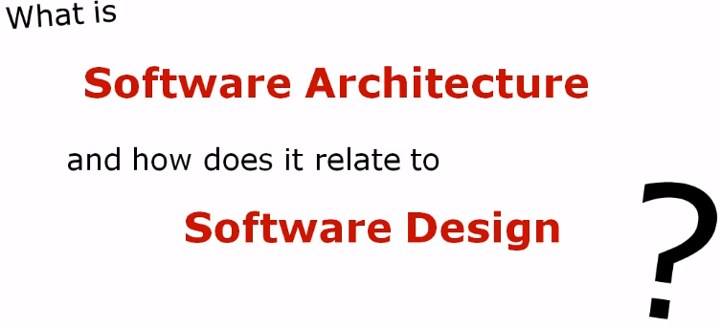

Slide 4
A Short Overview of Software Architecture
The software architecture of a computing system is the set of structures needed to reason about the system, which comprise software elements, relations among them, and properties of both.
Software architecture is the set of design decisions which, if made incorrectly, may cause your project to be cancelled.
Eoin Woods (SEI 2010)
A hierarchical element is any kind of element that can consist of like kind elements. A module is a hierarchical element because modules consist of sub modules, which are themselves modules. A task or a process is not a hierarchical element.

Slide 5
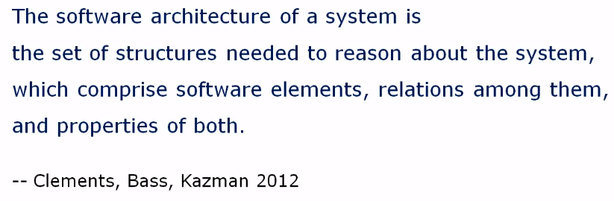
What is Software Architecture?

Slide 6
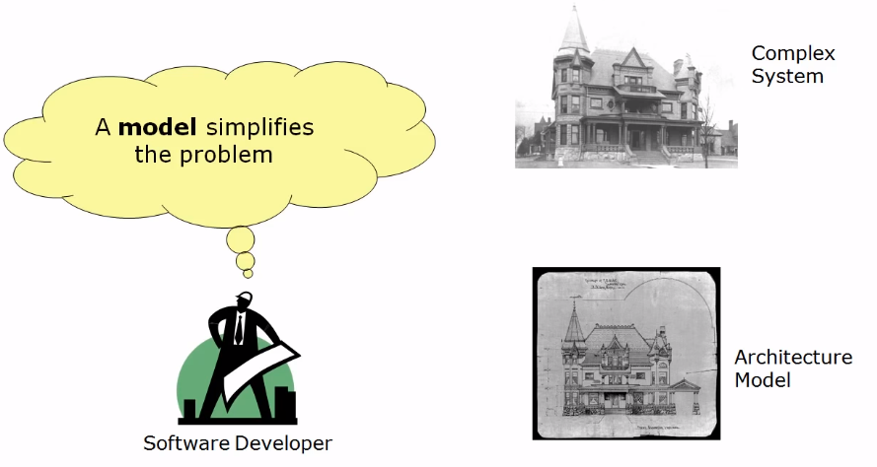
Book: Just Enough Software Architecture - by George H. Fairbanks (Author)

Slide 7
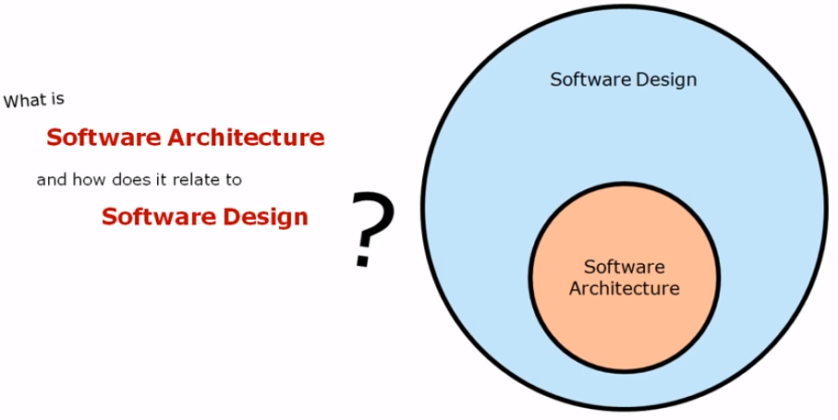
Book: Just Enough Software Architecture - by George H. Fairbanks (Author)

Slide 8
A Short Overview of Software Architecture
What’s the Difference Between Architecture and Design?
The first thing we can say is that clearly architecture is design, but not all design is architecture.
Why Document Software Architecture?
Creating an architecture isn’t enough. It has to be communicated in a way to let its stakeholders use it properly to do their jobs. If you go to the trouble of creating a strong architecture, you must go to the trouble of describing it in enough detail, without ambiguity, and organized so that others can quickly find needed information.

Slide 9
Architecting Software the SEI Way - Software Architecture Fundamentals: Technical, Business, and Social Influences
Although software architecture is a key factor in determining the success or failure of a software system, software professionals throughout the industry continue to struggle with questions like:
What exactly is a software architecture?
Why is software architecture important?
This is an introductory webinar from the US Software Engineering Institute that explains what is meant by software architecture and its business importance.
URL: https://resources.sei.cmu.edu/library/asset-view.cfm?assetid=21534
What is software architecture?
An interesting perspective on software architecture where the presenter sees it as a set of models that are needed to reason about risks of software failure.
URL: https://www.youtube.com/watch?v=Rn1g6V-vlHw

Slide 10
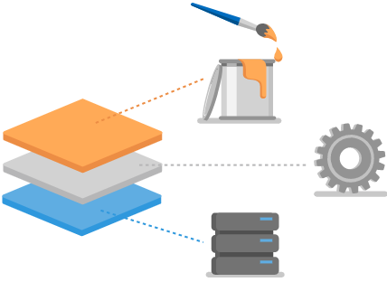

Slide 11
ASP.NET MVC Pattern
A design pattern for achieving a clean separation of concerns.
Model View Controller (MVC)
MVC is a design pattern used to decouple user-interface (view), data (model), and application logic (controller). This pattern helps to achieve separation of concerns.
Using the MVC pattern for websites, requests are routed to a Controller which is responsible for working with the Model to perform actions and/or retrieve data. The Controller chooses the View to display, and provides it with the Model. The View renders the final page, based on the data in the Model.

Slide 12
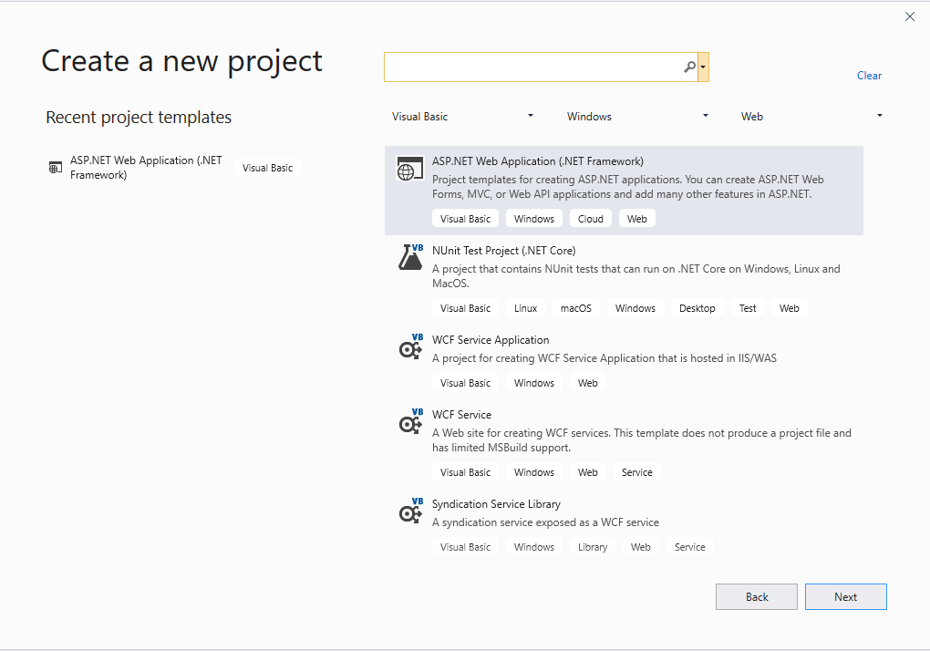
ASP.NET MVC Pattern … cont.

Slide 13
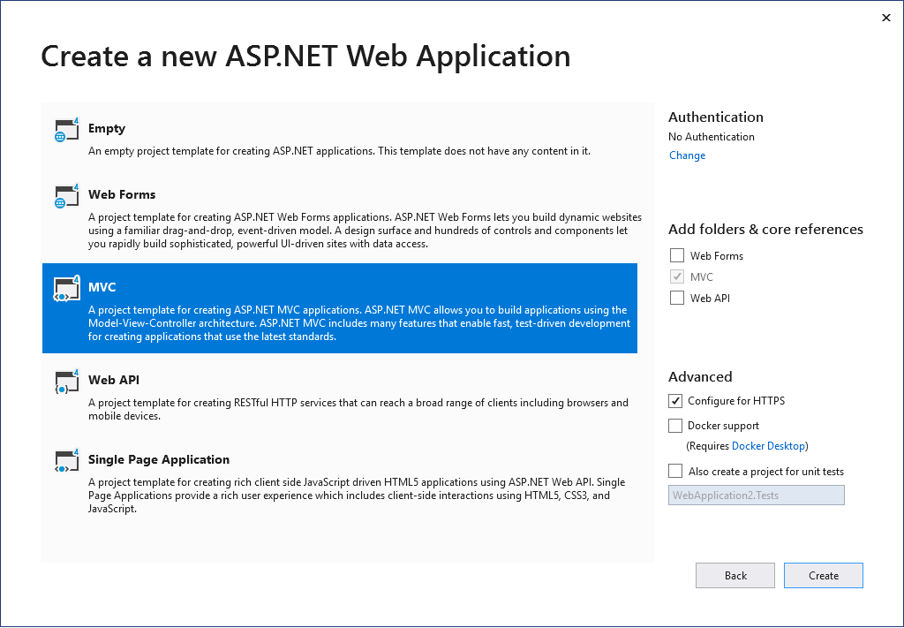
ASP.NET MVC Pattern … cont.

Slide 14
Chapter 1 – Architectural Design
Software Architecture and Design
Mutah University
Faculty of IT
Department of Software Engineering
Dr. Ra’Fat A. AL-Msie’Deen
rafatalmsiedeen@mutah.edu.jo
https://rafat66.github.io/Al-Msie-Deen/

